Slide 1
ALBERTA’s carbon tax
The process, the lessons learned, and a look ahead
Econ 366, April 2024

Slide 2
One of my rules: Always take calls from the government

Slide 3
Our emissions and targets

Slide 4
Canada’s emissions by province in 2015

Slide 5
Canada’s Emissions By Sector in 2015

Slide 6
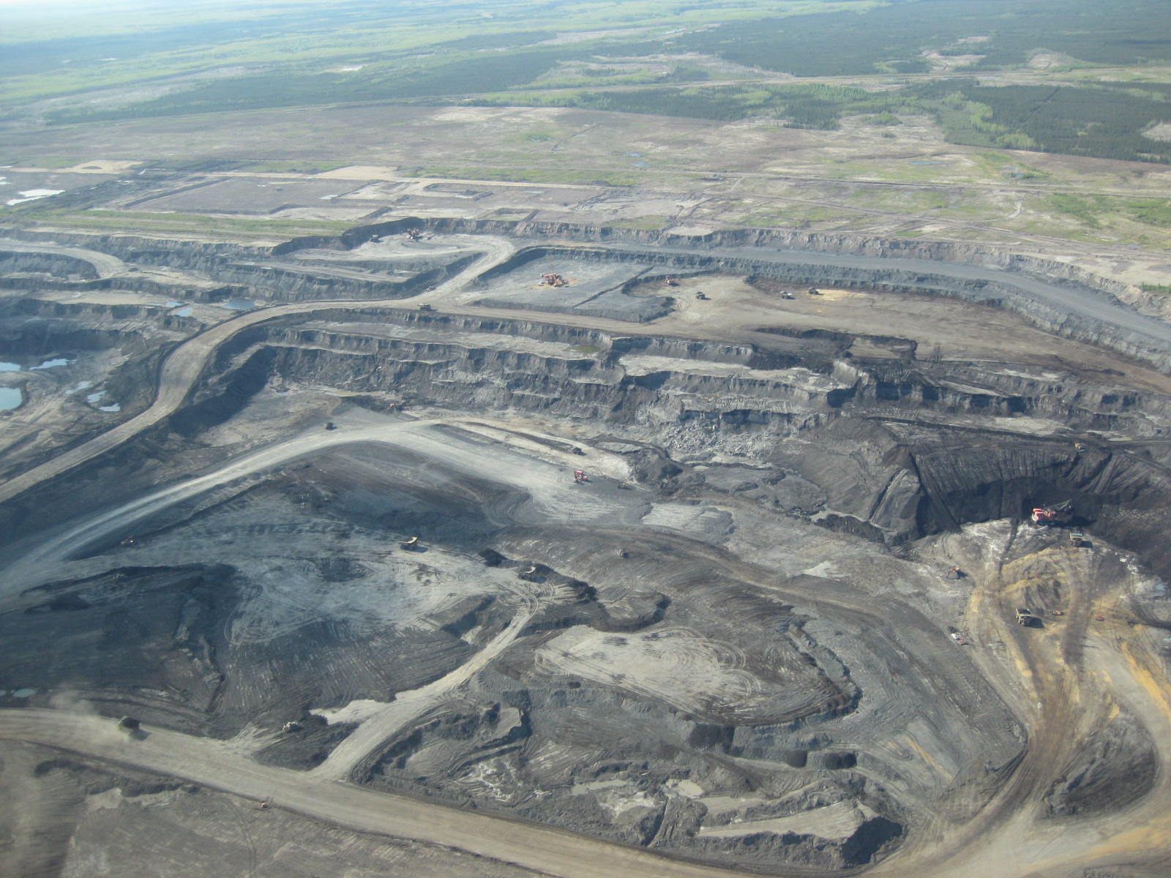
The biggest issue in Alberta in 2015 was oil sands

Slide 7
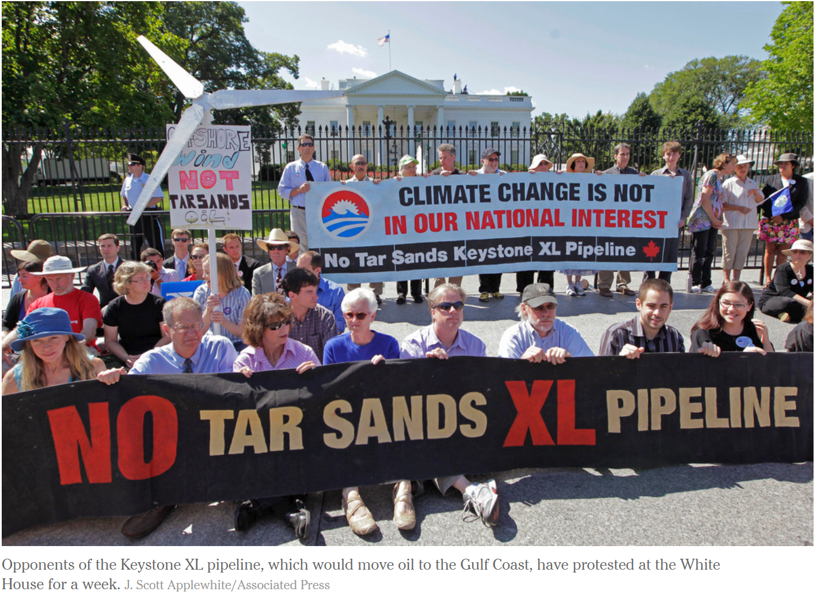
How many people came to know of the oil sands

Slide 8
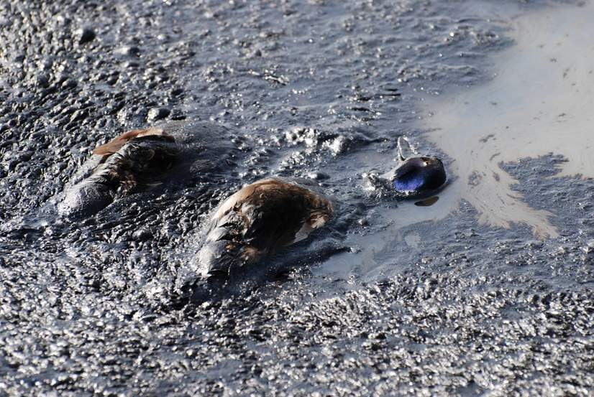
How many people came to know of the oil sands

Slide 9
What about electricity?

Slide 10
There was a federal election on the horizon

Slide 11
So, I SAID NO
University role
Watching friends navigate similar roles
Lack of political alignment with the new government

Slide 12
Then I said yes
When the Premier/Prime Minister calls, you say yes

Slide 13
AB Climate Policy Fundamentals Main components of CLP policy package
Carbon pricing was the backbone of the policy
$30/tonne price increasing over time
Separate designs for consumers and large emitters
Carbon-price-funded complementary policies
Incentives for renewable power with projected 30% renewable generation by 2030
Funding for energy efficiency initiatives and transit mode-shifting
Methane regulations with a goal of a 45% vents reduction by 2025
Coal power phased out by 2030
Competitiveness protections
Output-based allocations for trade-exposed sectors and electricity
Opt-in for smaller emitters
Consumer lump-sum, means-tested rebates
100 Mt cap on oil sands emissions

Slide 14
Carbon Levy and Carbon Competitiveness Regulation (CCIR)
An economy-wide carbon price starting at $30/tonne in 2018
Built on the existing SGER by:
Making it broader
Extended coverage from ~50% to ~80% of emissions
Making it better
Allocate permits based on sector-level benchmarks achieving competitiveness protection while not rewarding historic emissions
Making it progressive
Consumer rebates meant ~50% of Alberta households made better off in year 1.
Being able to build on an existing carbon was a huge advantage

Slide 15
Why is an economy-wide approach so important for Alberta?

Slide 17
What happened?

Slide 18
Federal policy
Source: Adam Scotti, PMO

Slide 19
There was lots of opposition

Slide 20
And the provincial carbon tax was scrapped in 2019

Slide 21
Despite the rhetoric, industrial carbon pricing remains under TIER

Slide 22
But evidence of big impacts in electricity

Slide 23
The price really matters here:

Slide 24
What went wrong?
Is a carbon tax the right policy?
Doesn’t the rebate destroy the effect of the carbon tax?
Overall economic malaise
Political circumstance

Slide 25
Do carbon taxes reduce emissions (enough)

Slide 26
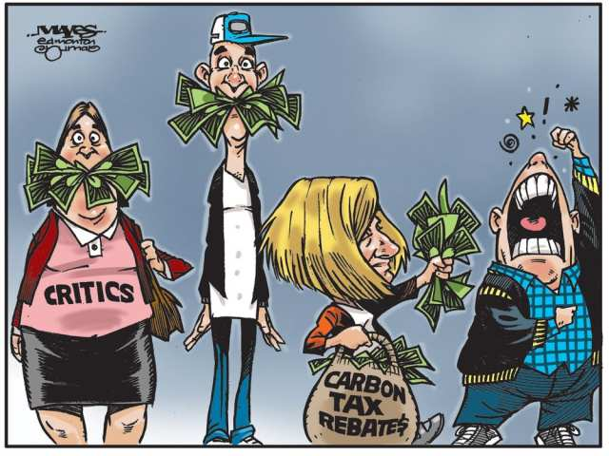
Misunderstanding of rebates was constant

Slide 27
And it provided great fodder for concern trolls

Slide 28
Tough Time to Implement Carbon Policy

Slide 29
Was the carbon tax really on the ballot?

Slide 30
Did Alberta Really Vote Differently?

Slide 31
Did Alberta Really Vote Differently?

Slide 32
Did Alberta Really Vote Differently?

Slide 33
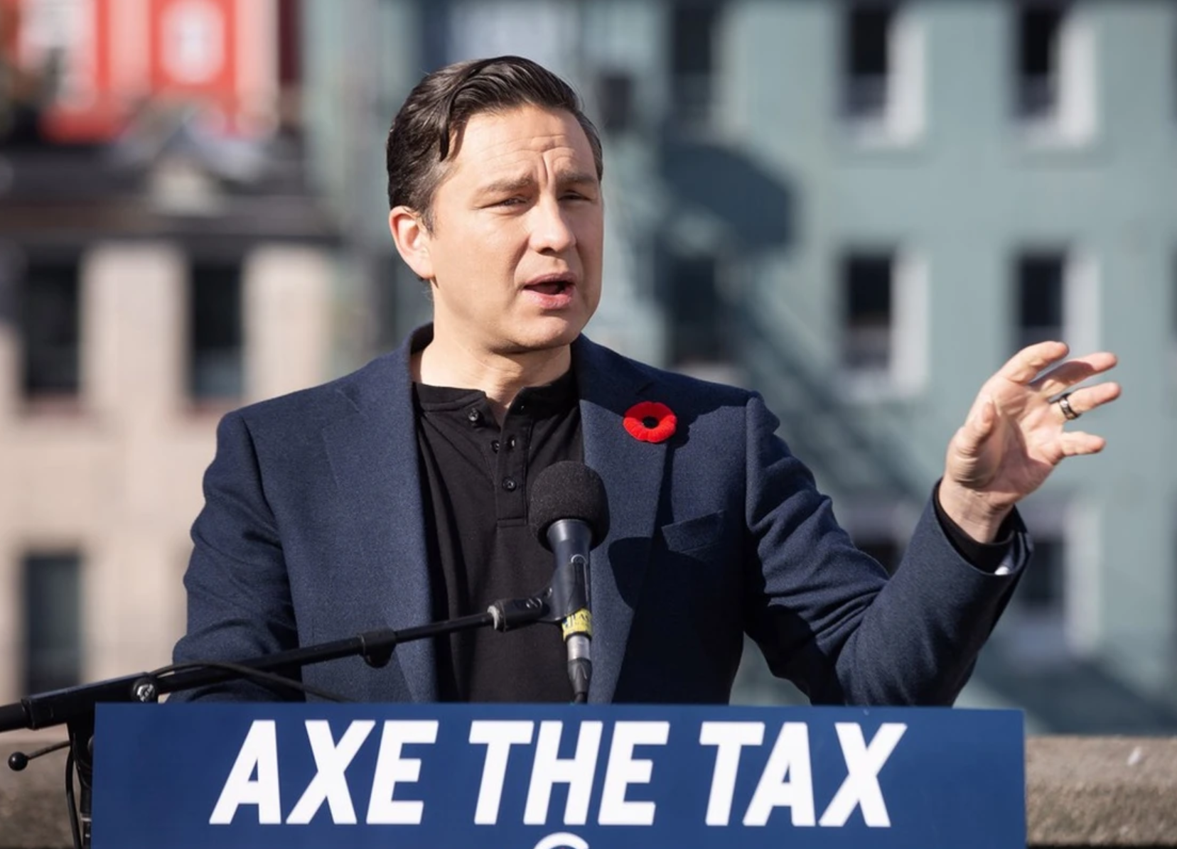
What’s next for Alberta?

Slide 34
What’s next for Alberta: more fights over provincial jurisdiction

Slide 35
What’s next for Alberta: a looming oil and gas cap

Slide 36
What’s next for Alberta: a battle for the country

Slide 37
Wrap up
You should definitely take the call
Don’t forget that government work is not like academic work – peer review starts after your work is public
Counterfactual analysis is challenging in a political arena
Don’t read too much into political outcomes
Keep fighting for good policy

Slide 38
Contact Information
Andrew Leach
University of Alberta
andrew.leach@ualberta.ca
Twitter: @andrew_leach

